Slide 1
Index Equal Value
2023/02/11
Hailey

Slide 2
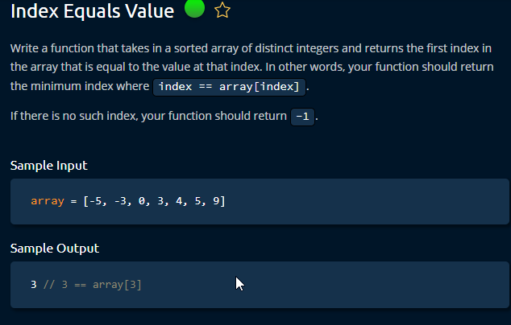

Slide 3
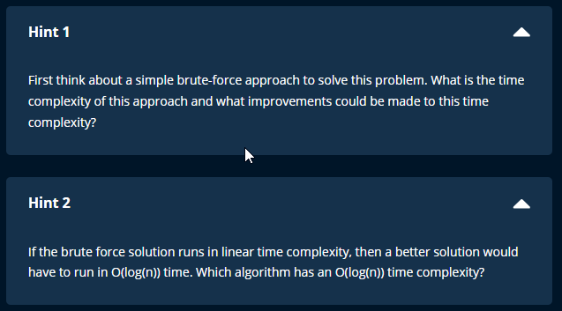

Slide 4
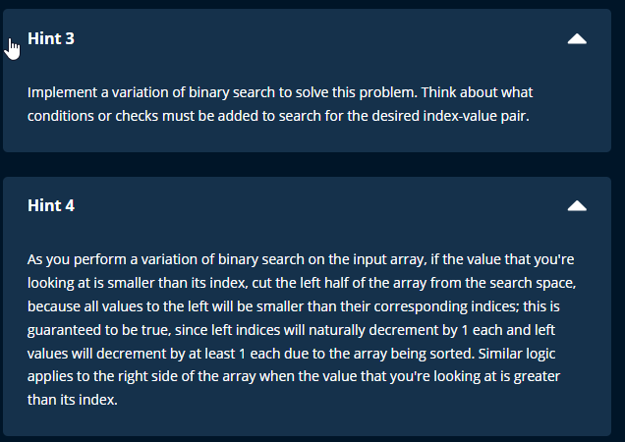

Slide 5
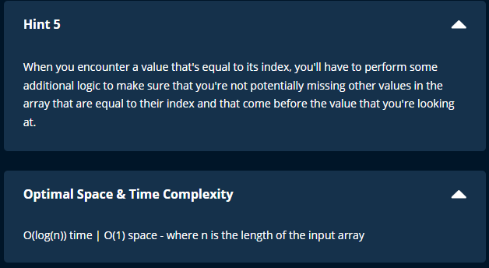

Slide 6
3 Methods (in increasing order of better space-time complexity)
Looping
Time = O (n)
Space = O(1)
2 functions and binary search mix
Time = O (log n)
Space = O (log n) (recursive : calling the function expand space)
Replace one function with a while loop
Time = O (log n)
Space = O (1)
!!! Basic of Binary Search is required to solve this problem.

Slide 7
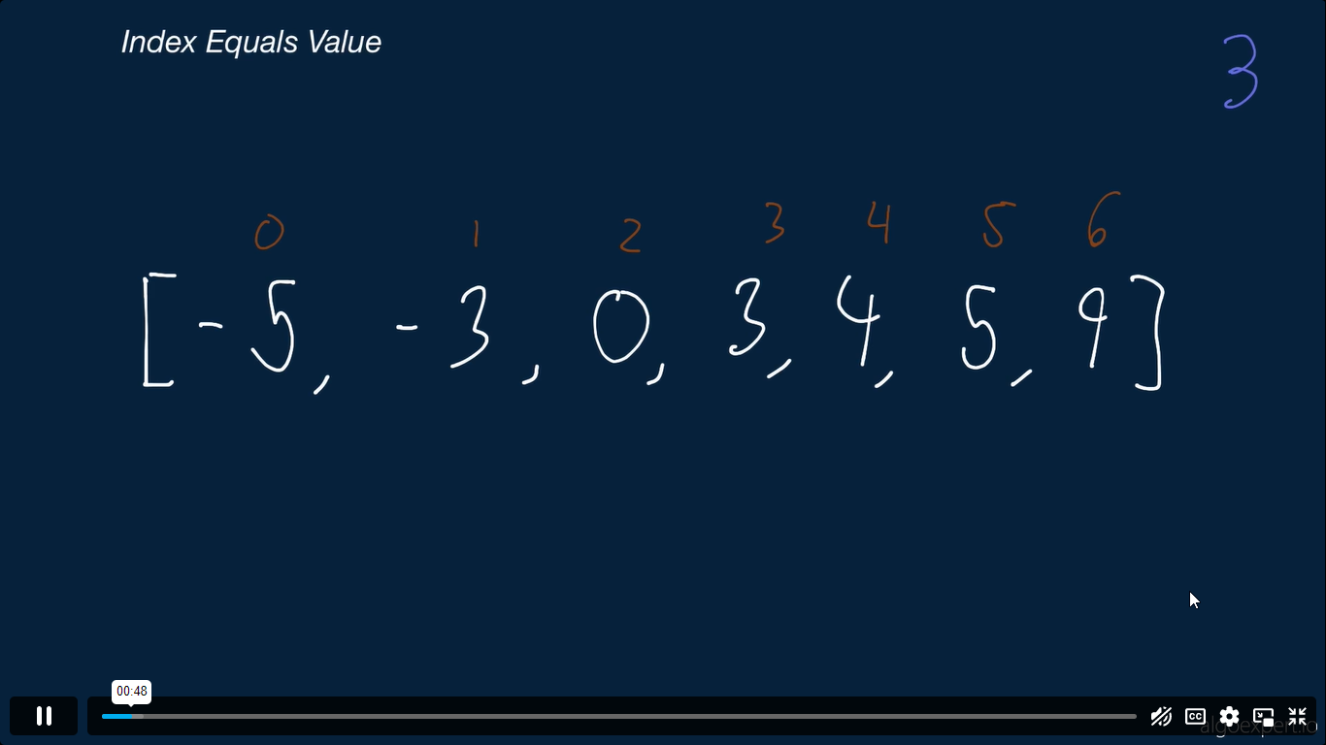

Slide 8
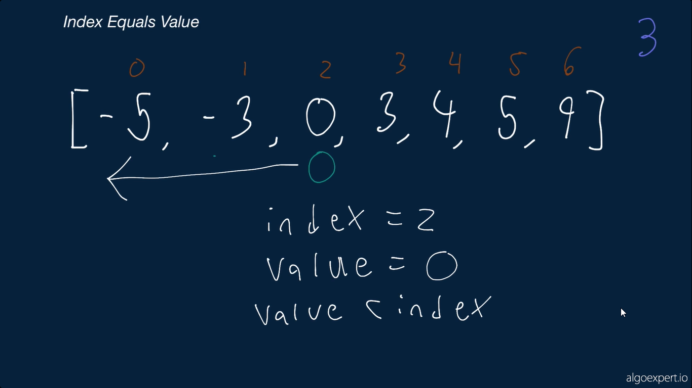

Slide 9
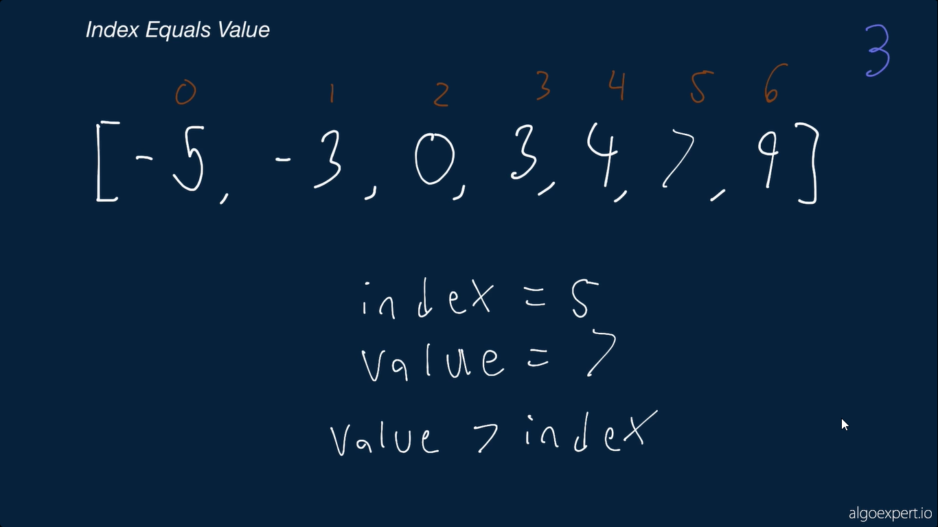

Slide 10
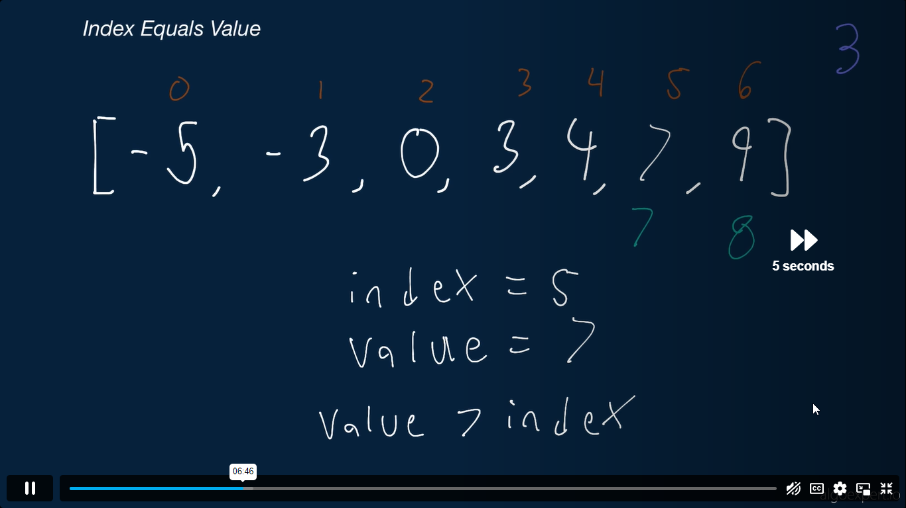

Slide 11
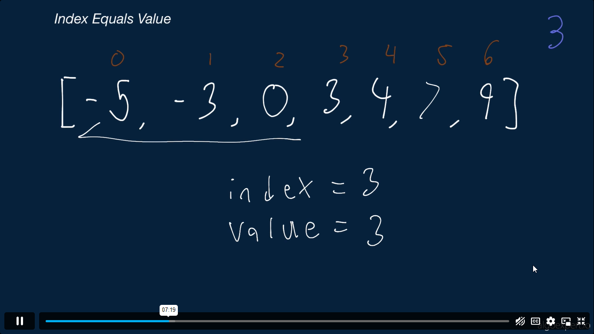

Slide 12
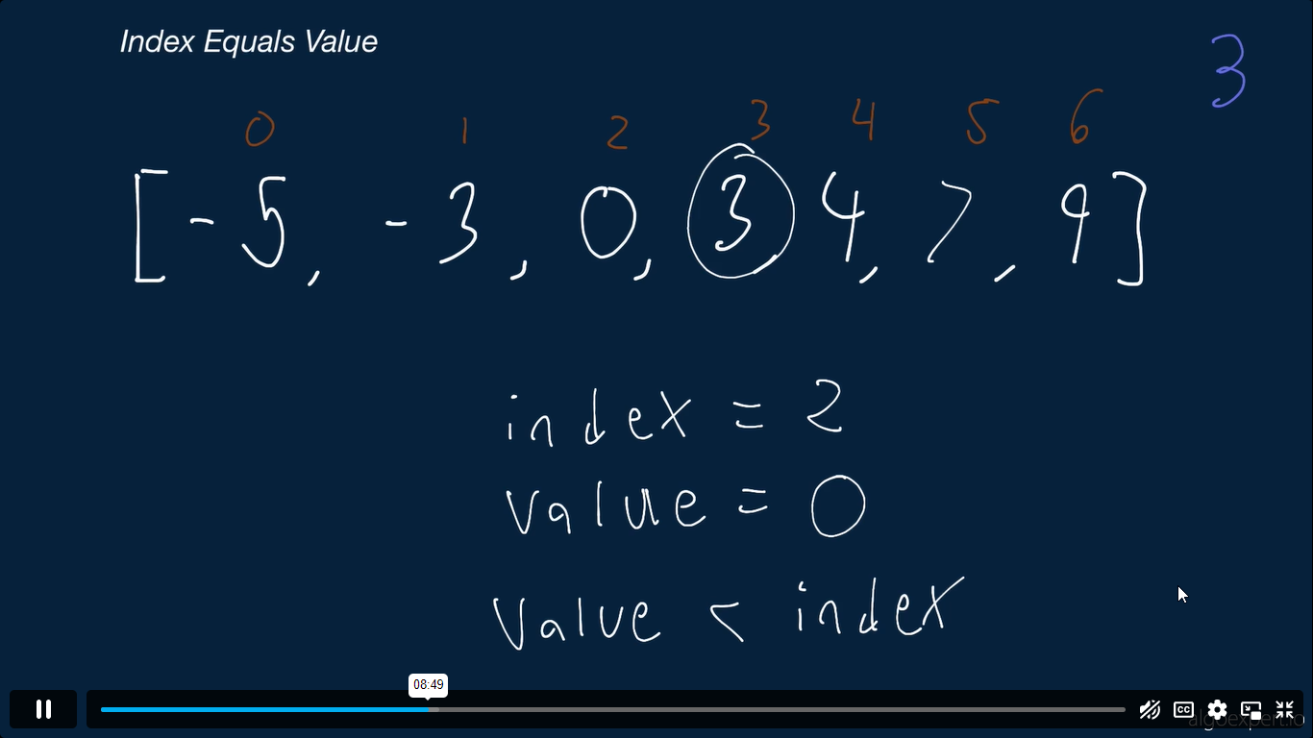

Slide 13
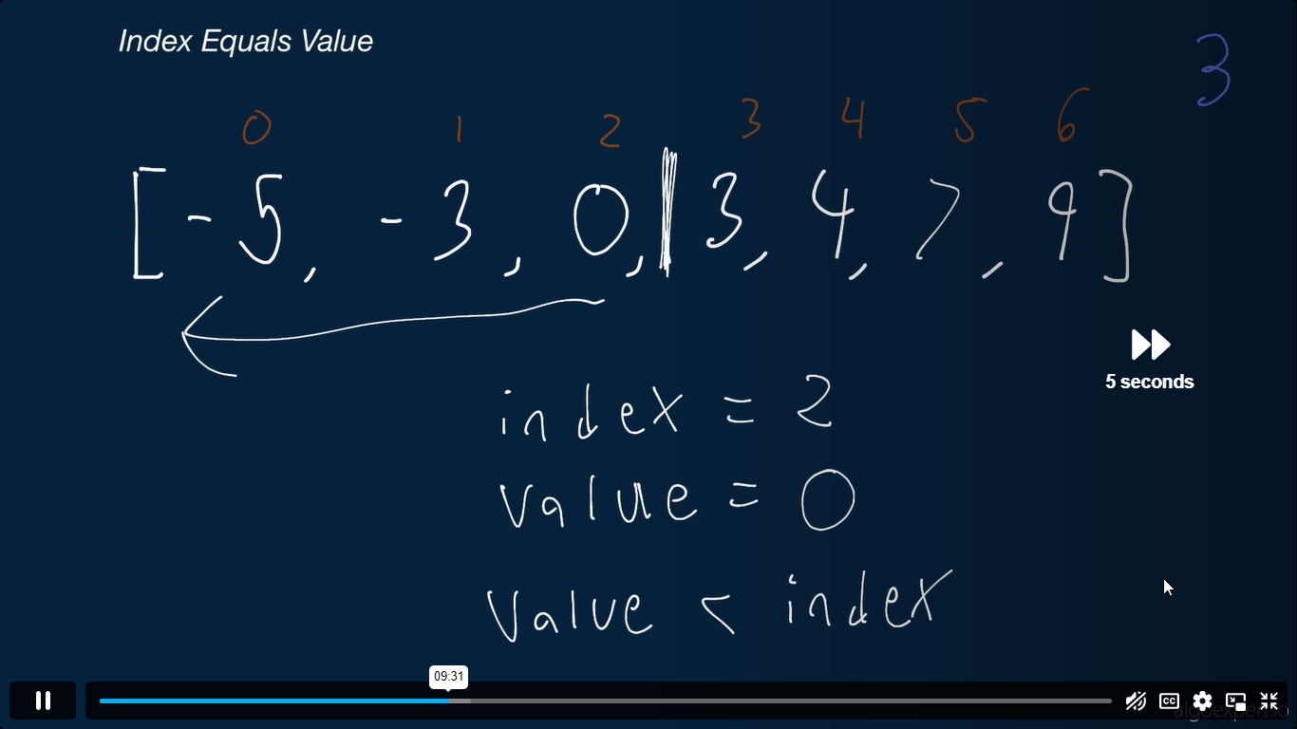

Slide 14
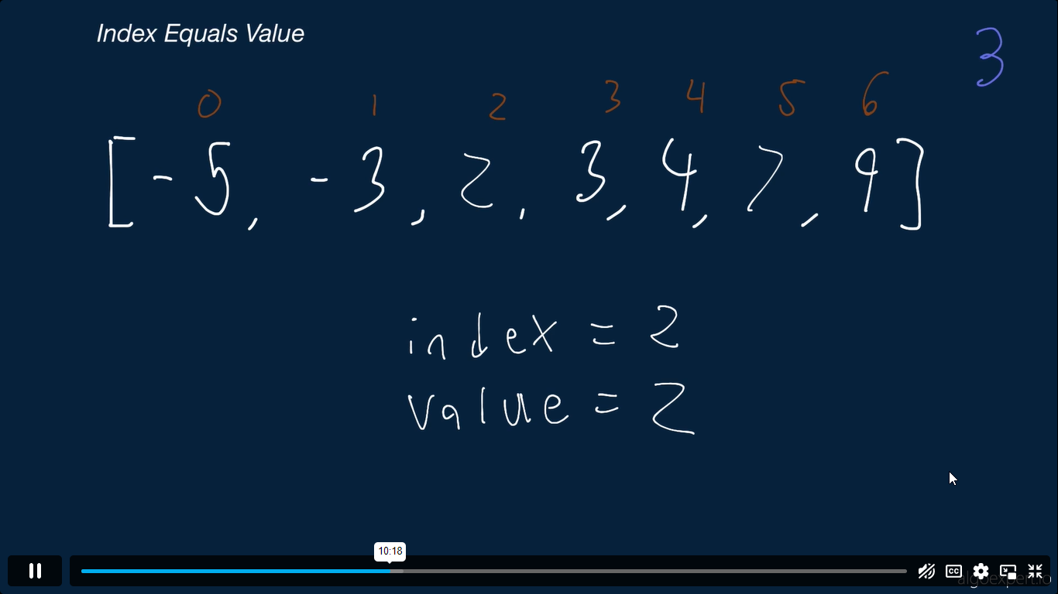

Slide 15
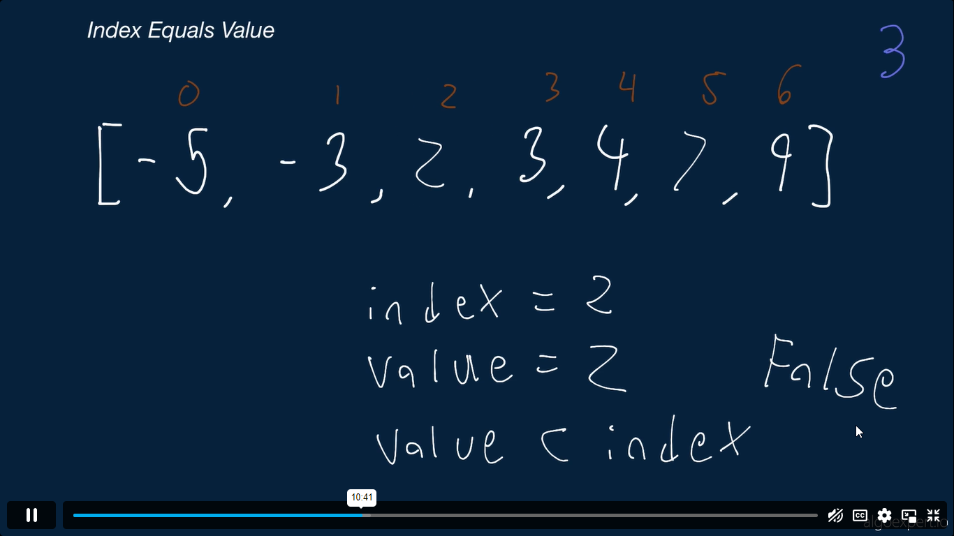

Slide 16
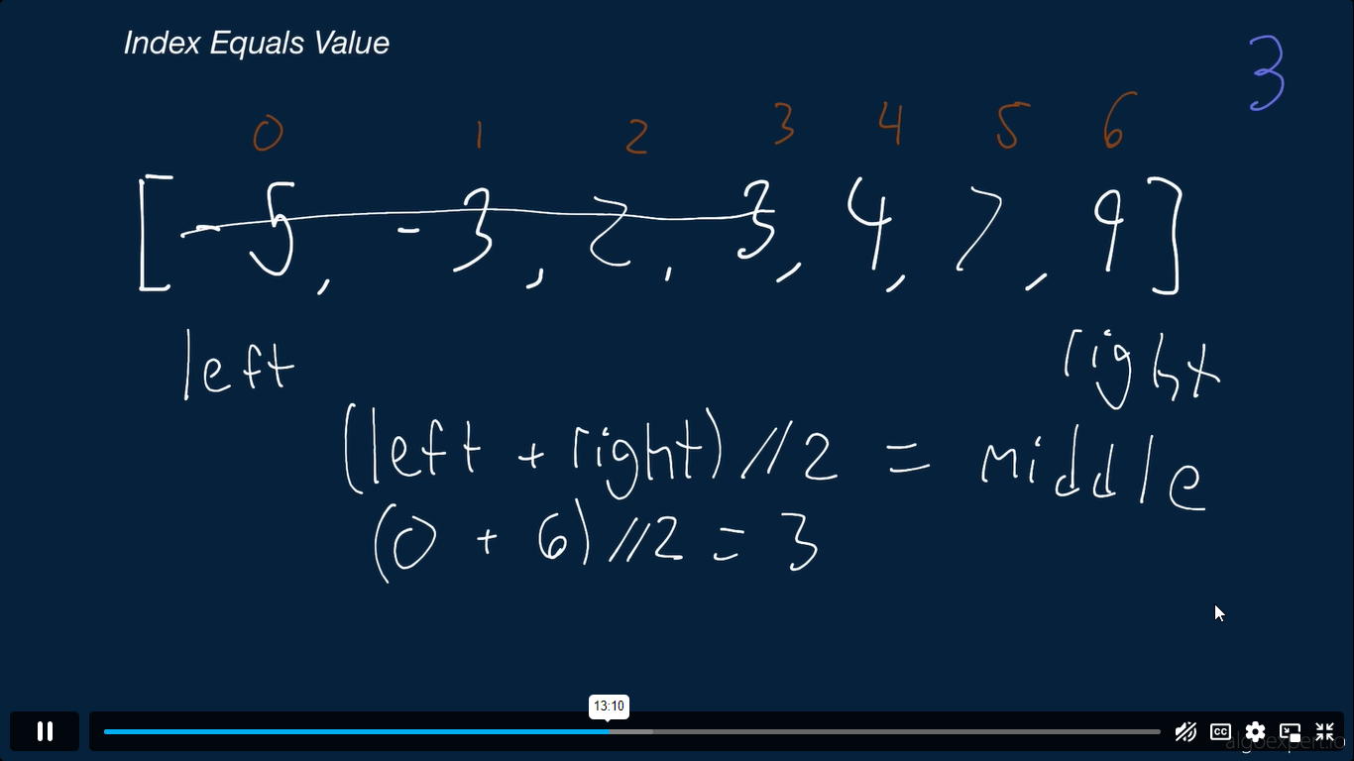

Slide 17
